Slide 1

Tracking Depression and Elucidating its Mechanisms using cognitive neuroscience or EEG through Machine Learning
21BT04058 Maitri Parmar
21BT04108 Itisha Sakhreliya
22BT04D147 Devanshi Dhabalia
22BT04D148 Rina Gohil

Slide 2
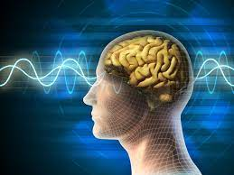
Contents
Introduction
What is EEG?
Depression and Brain
Objective
Expected Outcomes
Technology and tools
Challenges and limitations
Application
Conclusion

Slide 3
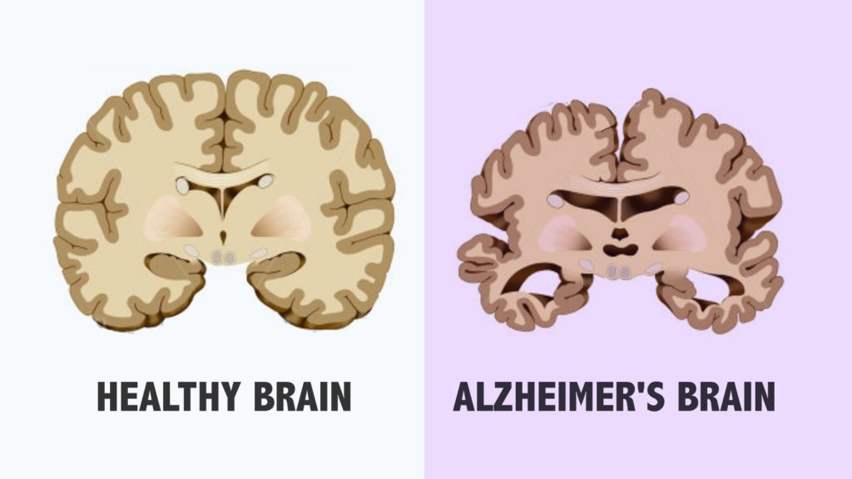
Introduction
Depression is a leading mental health disorder globally, affecting millions of people.
Understanding its neural mechanisms is crucial for improving diagnosis and treatment.
This project explores how cognitive neuroscience and machine learning can be combined to track and analyze depression using EEG data.
This project integrates cognitive neuroscience and machine learning to track and understand depression using EEG data.

Slide 4
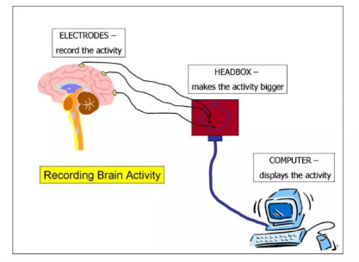
By analyzing brainwave patterns, we aim to identify neural markers and employ machine learning models to classify and predict depression levels. This approach seeks to uncover underlying mechanisms and improve diagnostic and therapeutic strategies for depression.

Slide 5
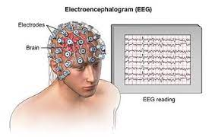
What is EEG?
EEG, or Electroencephalography, is a non-invasive method used to measure electrical activity in the brain.
It records brain wave patterns through electrodes placed on the scalp, providing real-time insights into neural activity,

Slide 6
what is cognitive neuroscience?
cognitive neuroscience refers to the study of how our brain processes thoughts, emotions, and behaviors.
It helps us understand how different areas of the brain function when someone is experiencing depression.
By using tools like EEG, which records brain activity, cognitive neuroscience allows us to see how depression affects the brain and identify patterns that could help in diagnosing and treating the condition.

Slide 7
Depression and the Brain
Depression is linked to changes in brain activity, especially in regions like the prefrontal cortex and amygdala.
EEG (Electroencephalography) measures brainwave patterns, providing insights into neural activity.
Altered Brain Activity:
Depression affects brain regions like the prefrontal cortex, amygdala, and hippocampus, impacting mood, emotion, and cognition.
Brain Networks:
Default Mode Network (DMN): Increased activity leads to excessive rumination.
Frontolimbic Network: Dysfunction impairs emotional regulation.

Slide 8
Objective
Track Depression: Utilize EEG data to monitor brainwave patterns associated with depression.
Identify Neural Markers: Pinpoint specific brainwave features linked to depressive states.
Machine Learning Classification: Develop models to classify and predict depression levels based on EEG data.
Neural Mechanisms: Gain insights into how brain functions are altered in depression.
Enhance Treatment: Contribute to more precise diagnostic and therapeutic strategies.

Slide 9
Methodology
Data Collection:
Participants will undergo EEG recording while performing cognitive tasks designed to trigger emotional and cognitive responses.
Data Preprocessing:
Artifact Removal: Filtering out noise such as muscle movements and eye blinks.
Feature Extraction: Identify key EEG features like power spectral density and event-related potentials (ERPs).
Machine Learning Models:
Choose and train models like Support Vector Machines (SVM), Random Forests, or Convolutional Neural Networks (CNN).
Split data into training and testing sets to evaluate model performance.

Slide 10
Expected Outcomes
Predictions and Classifications:
Accurately classify individuals as depressed or non-depressed based on EEG data.
Neural Insights:
Reveal specific brainwave patterns associated with depression.
Applications:
Improved diagnostic tools that can detect depression early.
Basis for developing targeted therapies.

Slide 11
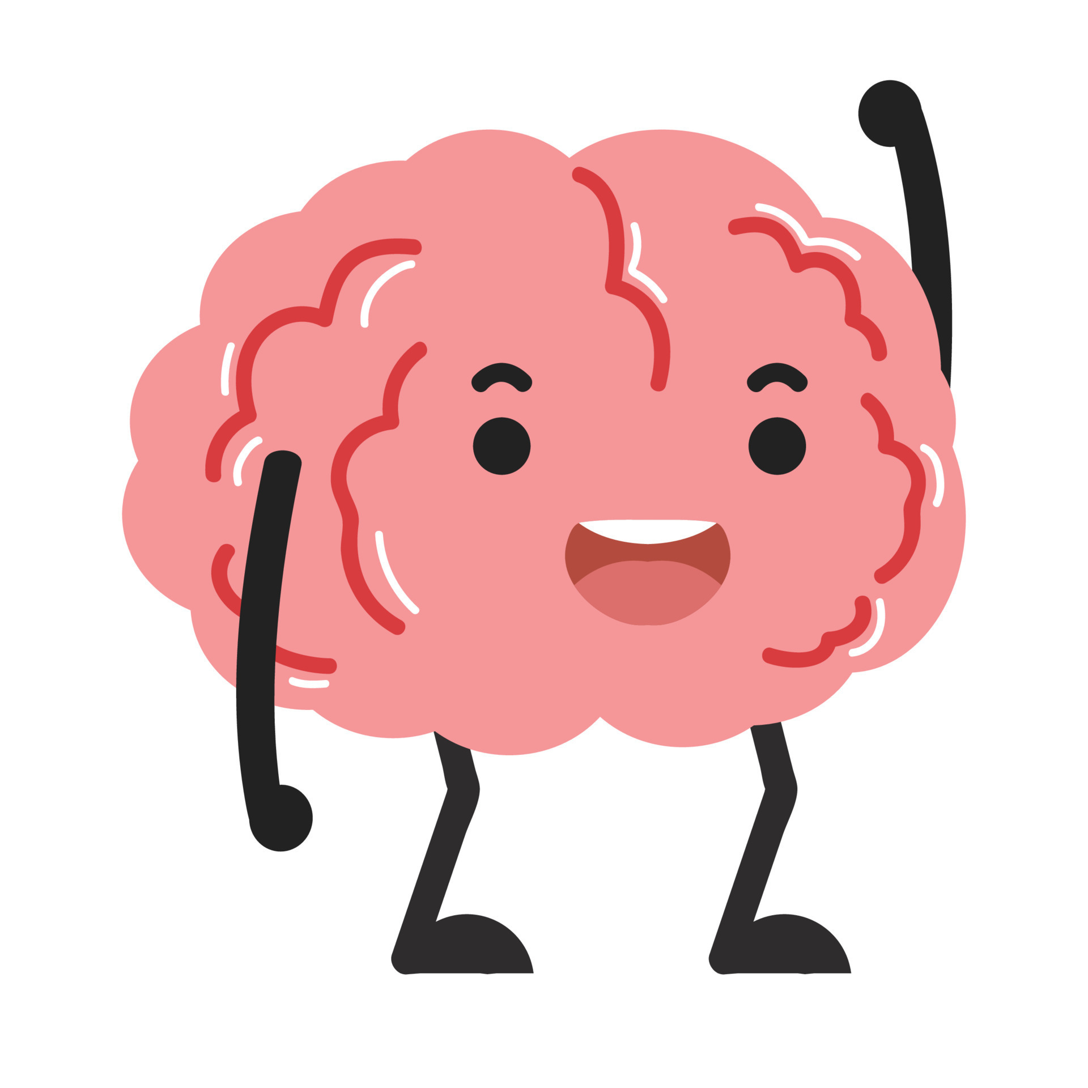
Technologies & Tools
Machine Learning Models: SNNs, LSTM, CNN, CNN-TCN, CNN-LSTM, SVM,
ANN, Logistic Regression, Random Forest, Decision Tree, KNN, XGBoost, RNN,
DNN, Ensemble Methods
Deep Learning Techniques: Deep Learning, Transfer Learning, Hybrid Models
EEG Analysis Techniques: Resting-state EEG, band power, neural oscillations,
asymmetry, neurofeedback

Slide 12
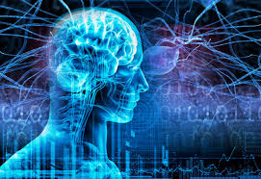
Challenges and Limitations
EEG Data Quality: Highlight issues like noise, artifacts, and variability in EEG signals that can affect data quality and model performance.
Generalizability: Discuss the challenge of generalizing findings across diverse populations, given that depression manifests differently among individuals.
Data Privacy and Ethics: Touch on the ethical considerations in handling sensitive EEG data, including data privacy and consent.

Slide 13
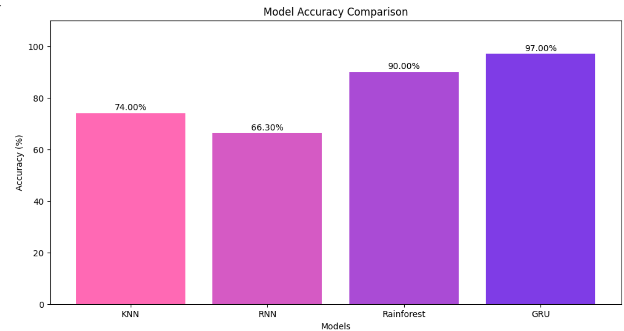
Accuracy

Slide 14
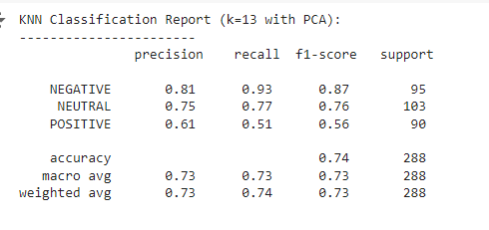
KNN Accuracy

Slide 15
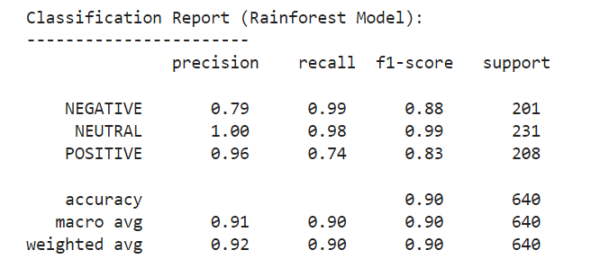
Reinforcement Accuracy

Slide 16
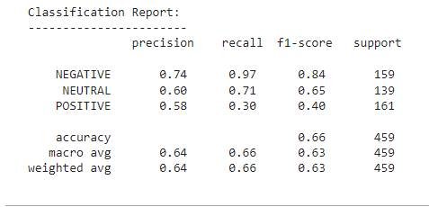
RNN Accuracy

Slide 17
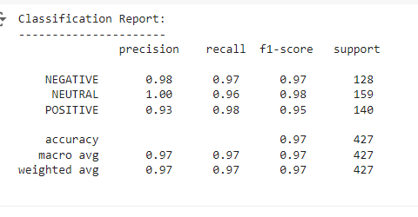
GRU Accuracy

Slide 18
Applications
Diagnostic Improvements:
EEG-based tools could provide non-invasive, real-time monitoring of depression.
Therapeutic Strategies:
Understanding neural mechanisms could lead to more personalized and effective treatments.
Future Research:
Potential to expand this approach to other mental health disorders.

Slide 19
Conclusion
This project explores how combining cognitive neuroscience, EEG, and machine learning can improve our understanding and tracking of depression.
By analyzing brain activity patterns, we can identify markers of depression and develop more accurate diagnostic tools. Machine learning helps classify and predict depression levels based on these patterns, allowing for personalized insights.
These advancements have the potential to improve depression diagnosis and treatment, leading to better outcomes for patients. Continued research in this area will enhance mental health care by providing innovative, data-driven strategies.

